Slide 1
Introduction to TOEFL iBT Writing Tasks
Task 1: Integrated
A. Read a text (3 minutes)
B. Listen to a lecture (2 minutes)
C. Write your response (20 minutes) (200 to 250 words or over)
2. Task 2: Academic Discussion
A. Read a three-part prompt
B. Write your response (10 minutes) (100 words or over)

Slide 2
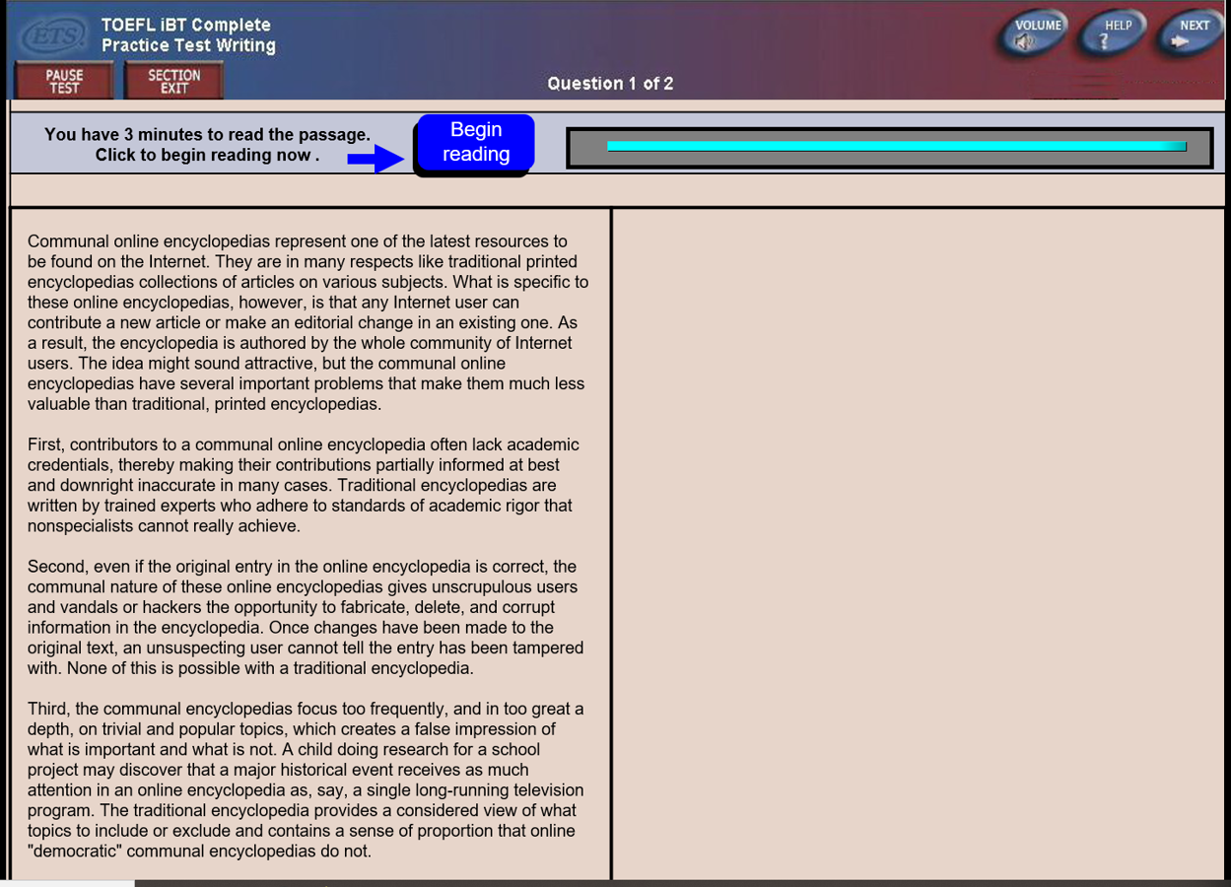
Task 1: Integrated Writing

Slide 4
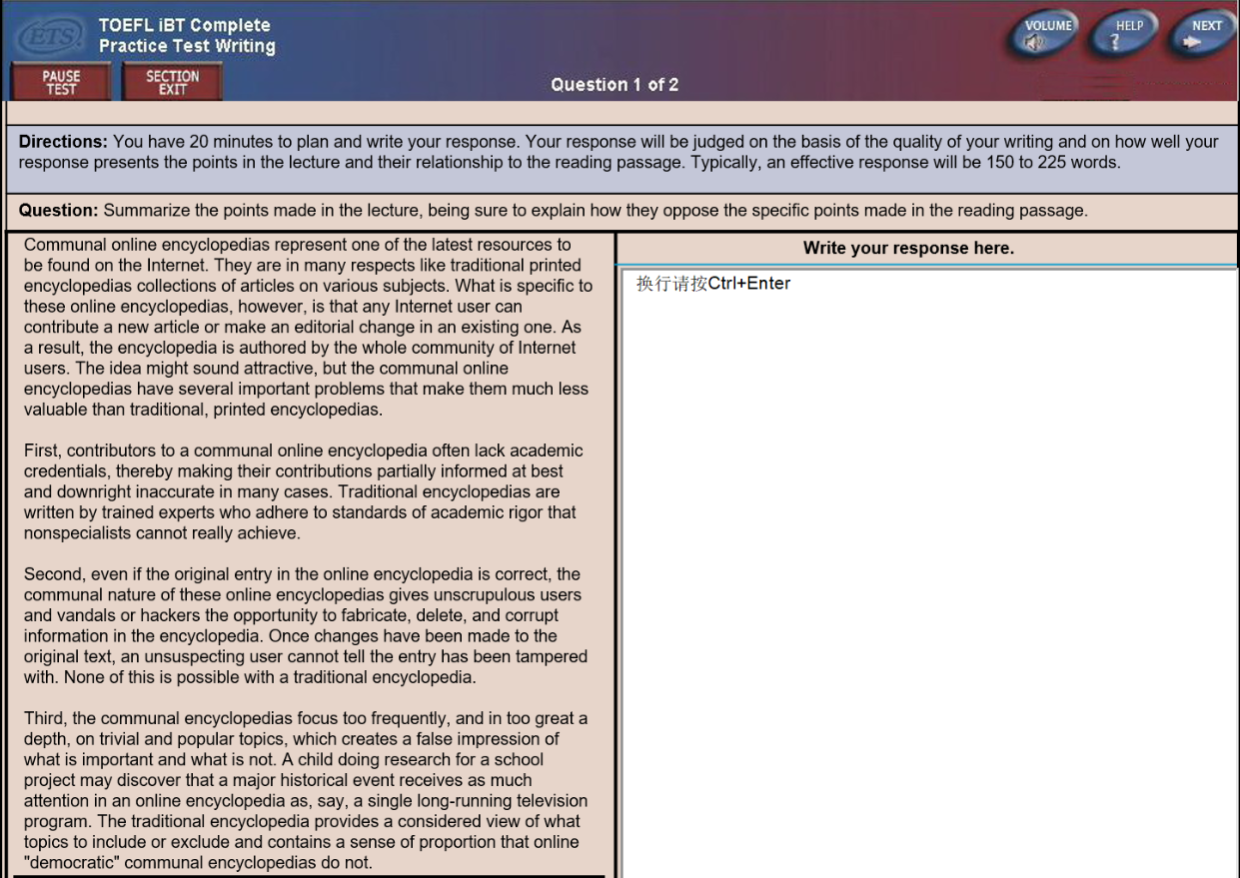

Slide 5
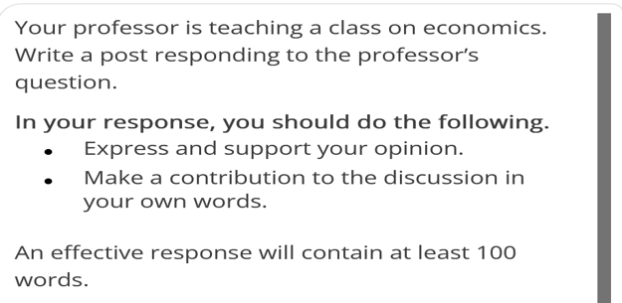
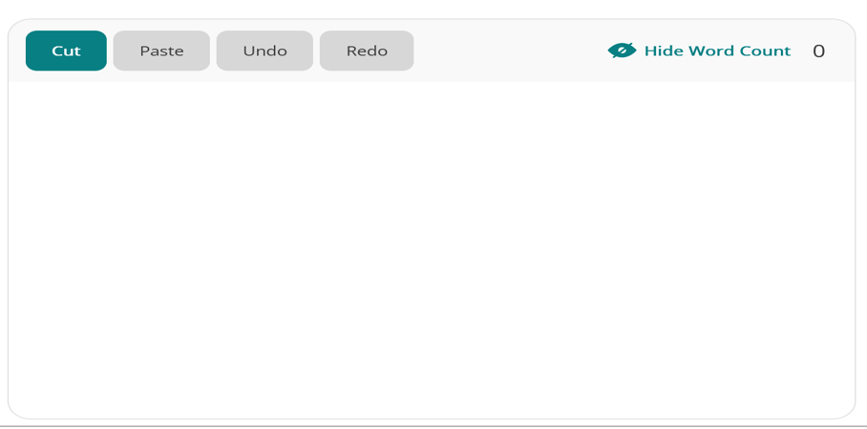
Task 2: Academic Discussion

