Slide 1
Writing Week 1

Slide 2
Writing
Task 1 | Integrated (Read- Listen- Write) 20 Minutes 150-225 Words
Task 2 | Writing for an Academic Discussion 10 Minutes At least 100 words
 | 30 Minutes

Slide 3
Writing: Integrated Task
3 STEPS
READING(3 Minutes) | LISTENING 2-3 Minutes. | Writing Time: 20 Minutes State the points from the lecture and explain how they support or reject the reading passage. Words: 150-225

Slide 4
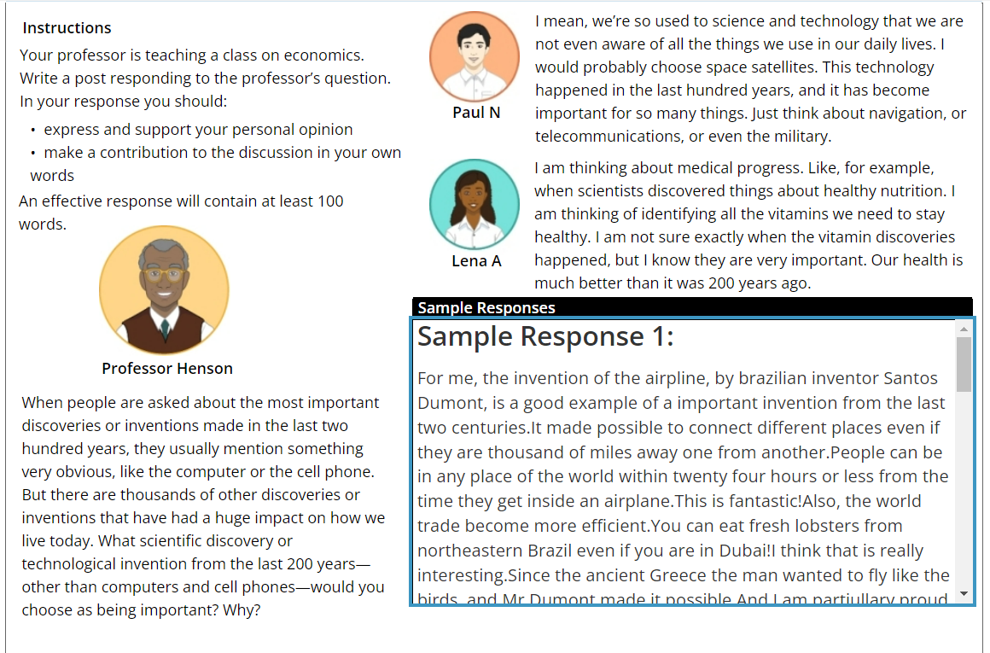
Writing for an Academic Discussion

Slide 5
Writing Scoring Criteria

Slide 6
Writing for an Academic Discussion

Slide 7
How to Improve Your TOEFL Writing Skill
1. Read sample topics
2. Read samples by TOP SCORERS
3. Develop your own framework and writing strategy. Learn. Do not memorize.

Slide 8
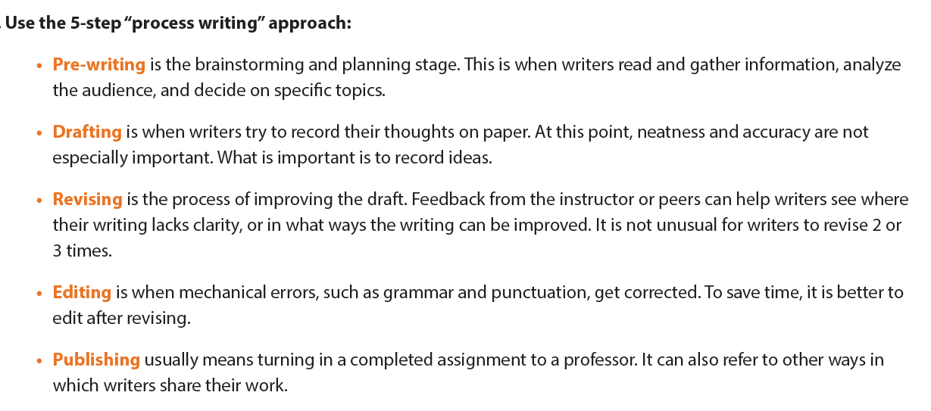
How to Improve Your TOEFL Writing Skill

Slide 9
A good paragraph
Topic sentence (TS) | A topic sentence is the most important sentence in a paragraph. Sometimes referred to as a focus sentence, the topic sentence helps organize the paragraph by summarizing the information in the paragraph. A good topic sentence is specific enough to give a clear sense of what to expect from the paragraph, but general enough that it doesn't give everything away.
Explain your TS | 2-4 sentences In fact, This is because….
Provide evidence (examples) | For example, To illustrate,

Slide 10
Sample Topic
Do you agree or disagree with the statement? People will spend less time cooking and preparing food in twenty years.

Slide 11
Topic Sentences: make sure your TS clearly addresses the question.
Agree:
TS 1: First, people’s lives get more complicated day by day, leaving them less time to allocate to cooking.
TS 2: Second, as technology develops, there will be more cooking appliances which will facilitate cooking and shorten the time people spend on preparing food.

